Slide 1
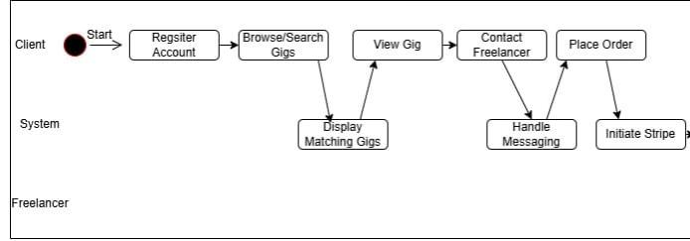
Freelance Forge – Activity Diagram

Slide 2
